Slide 1
Case study title
Suresh Marpu

Slide 2
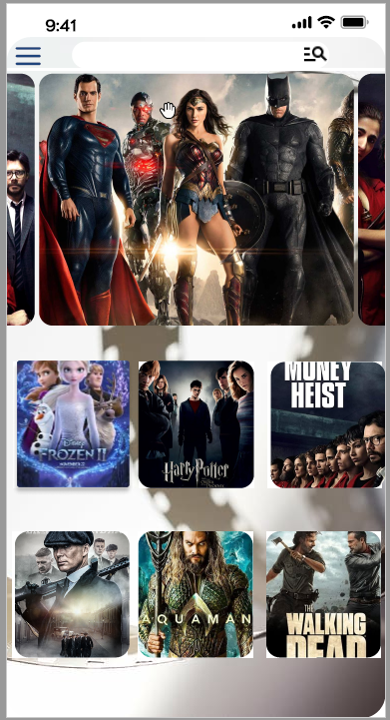
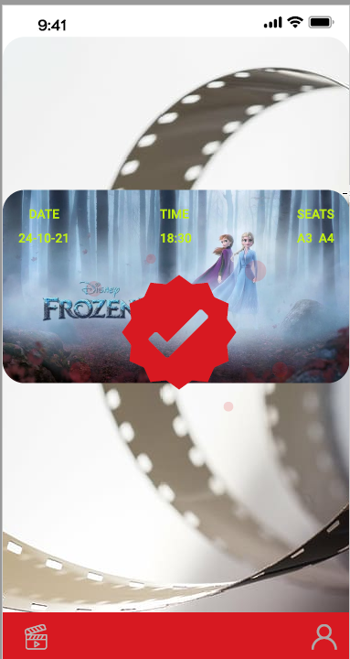
Project overview
The product:
Design a mobile ticketing app for a movie theater for any movie buffs.
Preview of selected polished designs.
Project duration:
Oct 2021 – Jan2021

Slide 3
Project overview
The problem:
To Desing a better Movie App which enables smooth and convient way to book
The goal:
Design an app for movie booking made Easy

Slide 4
Project overview
My role:
Entry level UX designer
Responsibilities:
user research, wireframing, prototyping, etc.

Slide 5
User research
Personas
Problem statements
User journey maps
Understanding
the user

Slide 6
User research: summary
I Conducted interviews and created empathy maps to understand the users I’m designing for and their needs. A primary user group identified through research is young Students and Adults Who are facing issues in ticket booking
Initial Asusmptions were conmfriemd about movie buffs, but we have other user groups who has problems while booking movie tickets just before move start time.

Slide 7
User research: pain points
1
2
3
Accesibility
FILTER
IA
Users needs a change in date option in seat selection screen rather he needs to go back to previous screen
Users want to have filter to select a movie based on movie rating.
Text-heavy menus in apps are often difficult to read and book.

Slide 8
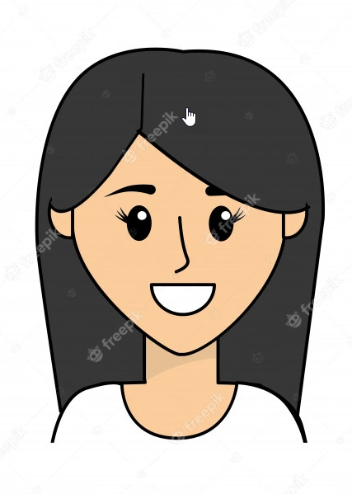
“I prefer watching a movie with my spouse to spend quality time.”
Add image that represents this persona
Goals
Find available couple seat easily.
Booking navigation and seat booking is hassle free
Frustrations
There are no filter options to show if gold class tickets(couple seats) availability.
There is no option to change the date in seat selection page to check availability. You need to go back all the way to date selection and re-process again.
Megha
Age:
Education:
Hometown:
Family:
Occupation:
28
Bachelors
Singapore
Married
Health worker.
Megha is newly married and a professional health workers. She get very little time in this pandemic time to spend quality time with her partner. The couple enjoy watching movies and spend quality time. It frustrates her that booking process for couple seats are very poorly managed.

Slide 9
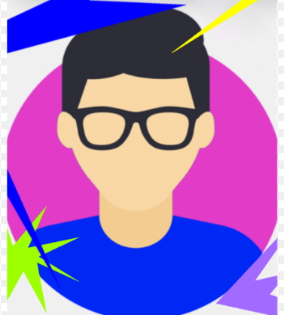
“Iam looking for app that will simplyfy movie ticket booking process.”
Add image that represents this persona
Goals
To spend less time in movie booking app.
To narrow down booking options quickly.
Frustrations
No ratings available to book a movie ticket when I would like to book a ticket on the go.
Harry
Age:
Education:
Hometown:
Family:
Occupation:
35
Masters in computers
Singapore
Single, lives alone
IT consultant
Harry is an IT consultant and lives alone. He gets board on week-ends and would like to watch movie without any prior planning. He gets frustrated when he don’t have any preferred movie in his mind. He expects a rating in booking app would make his life easy to select one.

Slide 10
User journey map
Persona: Harry
Goal: To narrow down booking options quickly
ACTION | Select CINEMA | Browse Menu | Book ticket | Complete Payment | Order Confirmation and Ticket recevied
TASK LIST | Tasks A. Research location of Cinemas. B. Check and promotions/Discounts. C.Read reviews about the cinemas. | Tasks A. Filter movies based on ratings B. Select movie from the list | Tasks A. Select seat B. Add food and combos C. Checkout | Tasks A. Add membership id B. Add promo-codes /Discount details C. Card Payment | Tasks A. Collect ticket & food B. Get to seat C. Watch movie
FEELING ADJECTIVE | Confused Excited | Confused | Hopeful Relieved Excited | Relieved Excited | Happy
IMPROVEMENT OPPORTUNITIES | Provide better search based on location specific. | Filter ratings based on Language /Genre | Date/time Change option makes life easier to explore more options. | Payment integration should be more easier and more Payment options makes easier. | Provide options to write reviews and user rating.

Slide 11
Paper wireframes
Digital wireframes
Low-fidelity prototype
Usability studies
Starting
the design

Slide 12
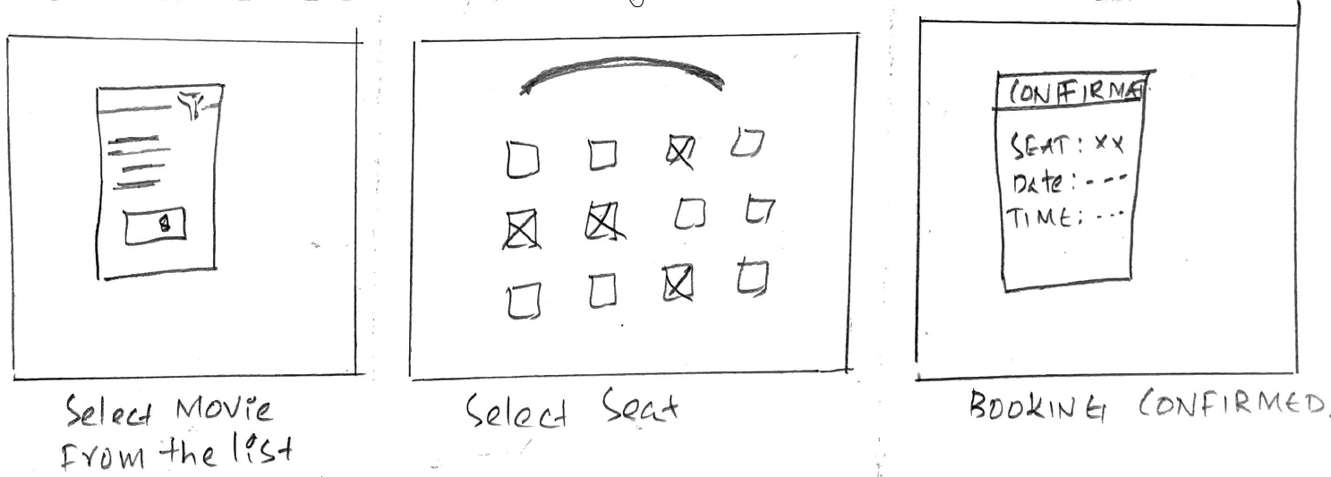
Paper wireframes
Taking the time to draft iterations of each screen of the app on paper ensured that the elements that made it to digital wireframes would be well-suited to address user pain points.

Slide 13
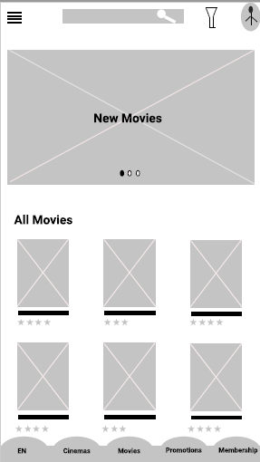
Digital wireframes
Main Screen for movie rolling
As the initial design phase continued, I made sure to base screen designs on feedback and findings from the user research.
Insert first wireframe example that demonstrates design thinking aligned with user research
List of movies

Slide 14
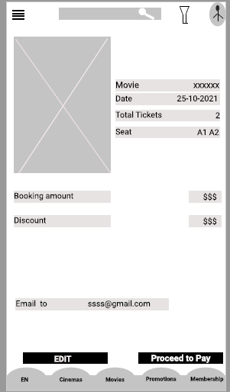
Digital wireframes
Movie
Easy navigation was a key user need to address in the designs in addition to equipping the app to work for even date changes screen to book tickets in the same screen.
Insert second wireframe example that demonstrates design thinking aligned with user research
Ticket booking
details

Slide 15
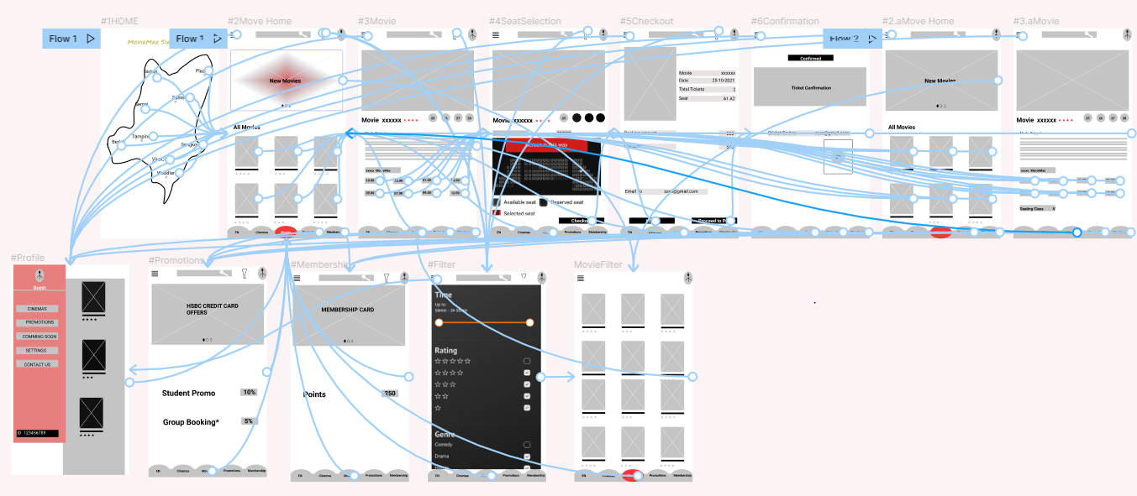
Low-fidelity prototype
Using the completed set of digital wireframes, I created a low-fidelity prototype. The primary user flow I connected was building a movie ticketing app so the prototype could be used in a usability study.
https://www.figma.com/file/2dA6fCYMpG9F6x4bHauWgM/Untitled?node-id=0%3A1

Slide 16
Usability study: findings
I conducted One round of usability studies. Findings from the first study helped guide the designs from wireframes to mockups and prototype well organized.
Round 1 findings
1
User wants to book a ticket as Guest. Profile creation is optional
2
User wants to have date change option in Seat selection screen and don’t want to go back and change again.
3
User wants to have Seat class type filter in seat booking option

Slide 17
Refining
the design
Mockups
High-fidelity prototype
Accessibility

Slide 18
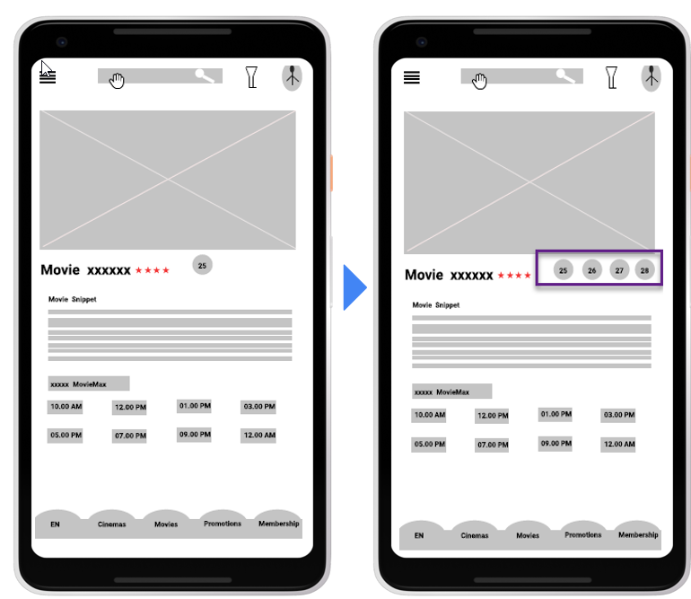
Mockups
Before usability study
After usability study
The Date change in seat selection screen makes life easy for the user when seats are full.
Image of selected screen before usability study
Image of selected screen after usability study

Slide 19
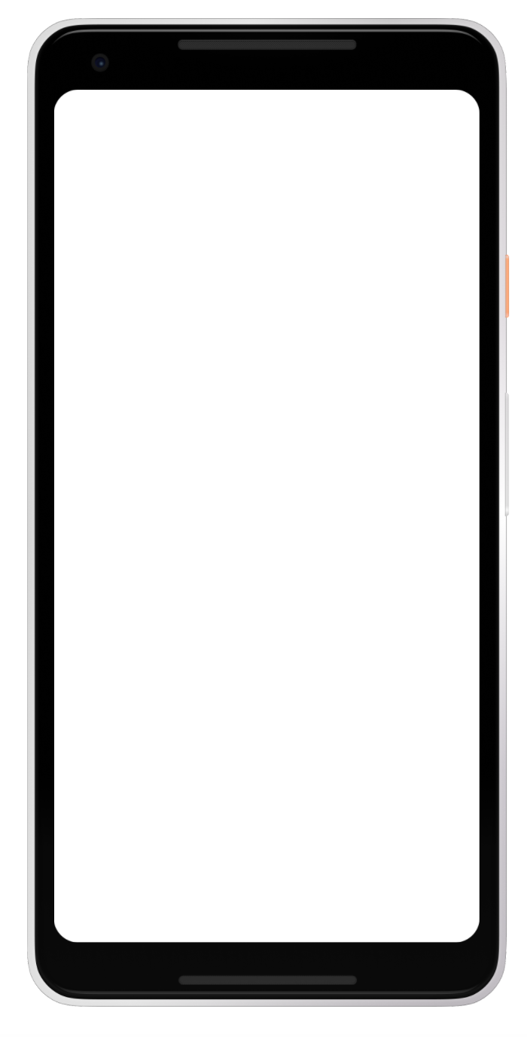
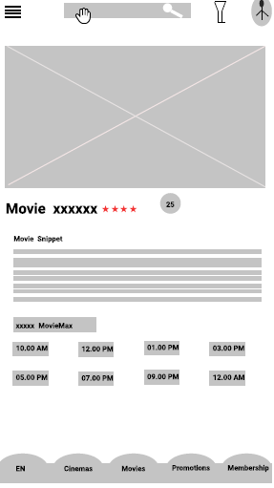
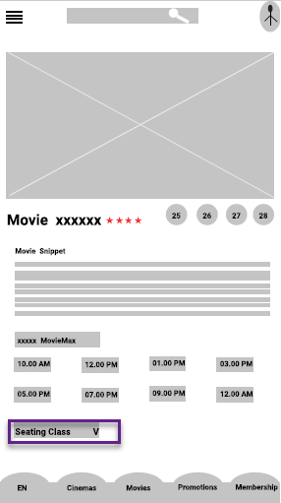
Mockups
Before usability study
After usability study
Most users found that option for Seating class selection would have time saving
Image of selected screen before usability study
Image of selected screen after usability study

Slide 20
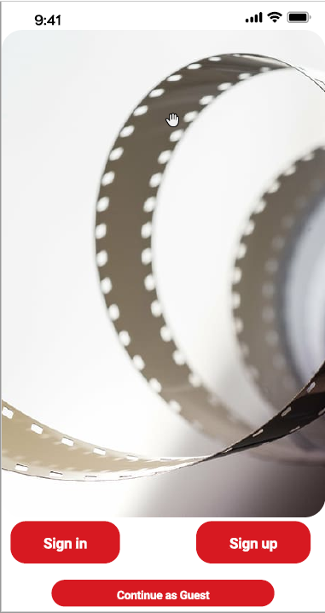
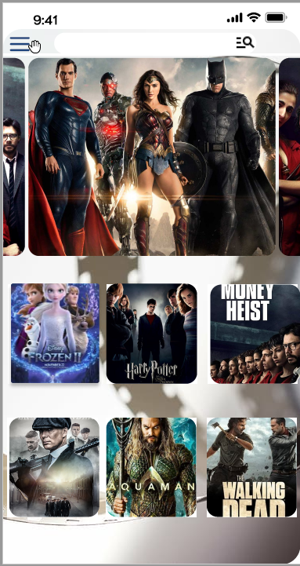
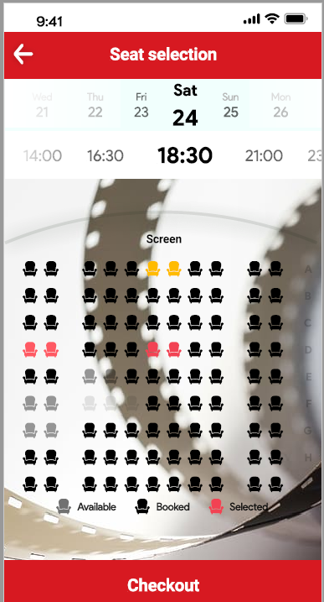
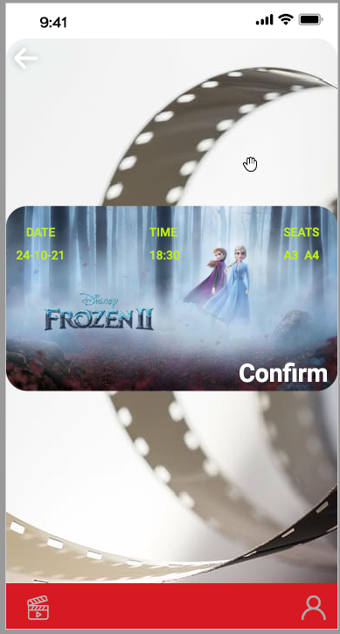
Mockups
Main mockup screen for display
Main mockup screen for display
Main mockup screen for display
Main mockup screen for display

Slide 21
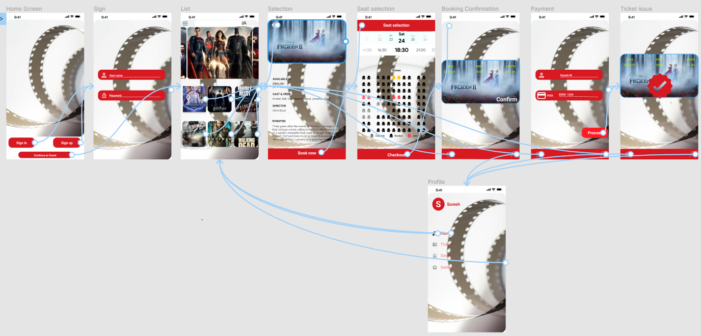
High-fidelity prototype
The final high-fidelity prototype presented cleaner user flows for building a move ticket.

Slide 22
Accessibility considerations
1
2
3
Provided access to users who are vision impaired through adding alt text to images for screen readers.
Used icons to help make navigation easier.
Used detailed move posters and move snippet to review the movie rating and star cast to select a movie based on their interest

Slide 23
Going forward
Takeaways
Next steps

Slide 24
Takeaways
Impact:
Insert The app was well received and able to book ticket and change the date and time in the seat selection screen.
What I learned:
I learned that the first ideas for the app are only the beginning of the process. Usability studies and peer feedback influenced each iteration of the app’s designs

Slide 25
Next steps
1
2
Conduct another round of usability studies to validate whether the pain points users experienced have been effectively addressed.
Conduct more user research to determine any new areas of need.

Slide 26
Insert a few sentences summarizing the next steps you would take with this project and why. Feel free to organize next steps in a bullet point list.
Let’s connect!
Thank you for your time reviewing my work on a movie ticketing App! If you’d like to see more or get in touch, my contact information is provided below.
Sureshmarpu@gmail.com
https://sureshmarpu.wixsite.com/my-site-1

Slide 27
Thank you!

